Slide 1
CHAPTER : THREE
Problem solving

Slide 2
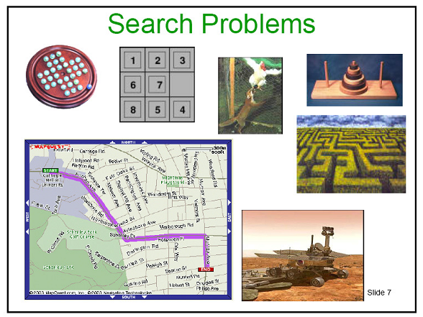
Can solve many problems with lots of computing power that humans are not good

Slide 3
Problem
It is a gap between what actually is and what is desired.
  A problem exists when an individual becomes aware of the existence of an obstacle which makes it difficult to achieve a desired goal or objective.
A number of problems are addressed in AI, both:
  Toy problems: are problems that are useful to test and demonstrate methodologies.
    Can be used by researchers to compare the performance of different algorithms
    e.g. 8-puzzle, n-queens, vacuum cleaner world, towers of Hanoi, …
  Real-life problems: are problems that have much greater commercial/economic impact if solved.
    Such problems are more difficult and complex to solve, and there is no single agreed-upon description
    E.g. Route finding, Traveling sales person, etc.

Slide 4
Solving a problem
Formalize the problem: Identify the collection of information that the agent will use to decide what to do.
Define states
  States describe distinguishable stages during the problem-solving process
  Example- What are the various states in route finding problem?
    The various places including the location of the agent
Define the available operators/rules for getting from one state to the next
  Operators cause an action that brings transitions from one state to another by applying on a current state
Suggest a suitable representation for the problem space/state space
  Graph, table, list, set, … or a combination of them

Slide 5
State space of the problem
The state space defines the set of all relevant states reachable from the initial state by (any) sequence of actions through iterative application of all permutations and combinations of operators
State space (also called search space/problem space) of the problem includes the various states
  Initial state: defines where the agent starts or begins its task
  Goal state: describes the situation the agent attempts to achieve
  Transition states: other states in between initial and goal states
Exercise– Find the state space for route finding problem where the agent wants to go from polle to shewaber.
  Think of the states reachable from the initial state until we reach to the goal state.

Slide 6
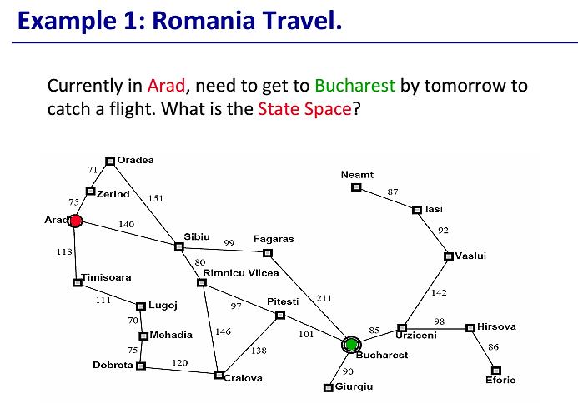
State space.
• States: the various cities you could be located in.
• Actions: drive between neighboring cities.
• Initial state: in Arad
• Desired condition (Goal): be in a state where you are in Bucharest.
Once the problem has been formulated as a state space search, various algorithms can be utilized to solve the problem
Solution will be the route, the sequence of cities to travel through to get to Bucharest.

Slide 7
Example 2: Coloring problem
  There are 3 rectangles. Both are initially white. The problem is to change all rectangles with white color to black color. Color change is one rectangle at a time. Define state space for coloring problem?

Slide 8
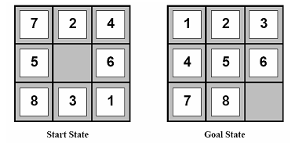
Example 3: The 8 puzzle problem
Arrange the tiles so that all the tiles are in the correct positions. You do this by moving tiles or space. You can move a tile/space up, down, left, or right, so long as the following conditions are met:
A) there's no other tile blocking you in the direction of the movement; and
B) you're not trying to move outside of the boundaries/edges.
State space.
• States: The different configurations of the tiles.
• Actions: Moving the blank up, down, left, right. Can every action be performed in every state?
• Initial state: as shown in the 1st picture.
• Desired condition (Goal): be in a state where the tiles are all in the positions shown in the 2nd picture
Solution will be a sequence of moves of the blank
that transform the initial state to a goal state.

Slide 9
Knowledge and types of problems
There are four types of problems:
  Single state problems (Type 1)
  Multiple state problems (Type 2)
  Exploration problems (Type 3)
  Contingency Problems (Type 4)
This classification is based on the level of knowledge that an agent can have concerning its action and the state of the world
Thus, the first step in formulating a problem for an agent is to see what knowledge it has concerning
  The effects of its action on the environment
  Accessibility of the state of the world
This knowledge depends on how it is connected to the environment via its percepts and actions

Slide 10
Single state problem
Fully observable: The world is accessible to the agent
  It can determine its exact state through its sensors
  The agent’s sensor knows which state it is in
Deterministic: The agent knows exactly the effect of its actions
  It can then calculate exactly which state it will be in after any sequence of actions
Action sequence is completely planned

Slide 11
Multiple state problems
Partially observable: The agent has limited access to the world state
  It might not have sensors to get full access to the environment states or as an extreme, it can have no sensors at all (due to lack of percepts)
Deterministic: The agent knows exactly what each of its actions do
  It can then calculate which state it will be in after any sequence of actions
If the agent has full knowledge of how its actions change the world, but does not know of the state of the world, it can still solve the task

Slide 12
Contingency Problems
Partially observable: The agent has limited access to the world state
Non-deterministic: The agent is ignorant of the effect of its actions
Sometimes ignorance prevents the agent from finding a guaranteed solution sequence.
Many problems in the real world are contingency problems (exact prediction is impossible)
  For this reason many people keep their eyes open while walking around or driving.
Suppose the agent is in Murphy’s law world
  The agent has to sense during the execution phase, since things might have changed while it was carrying out an action. This implies that
    the agent has to compute a tree of actions, rather than a linear sequence of action.

Slide 13
Exploration problem
The agent has no knowledge of the environment
  World Partially observable : No knowledge of states (environment)
    Unknown state space (no map, no sensor)
  Non-deterministic: No knowledge of the effects of its actions
  Problem faced by (intelligent) agents (like, new born babies)
This is a kind of problem in the real world rather than in a model, which may involve significant danger for an ignorant agent. If the agent survives, it learns about the environment
The agent must experiment, learn and build the model of the environment through its results, gradually, discovering
  What sort of states exist and What its action do
  Then it can use these to solve subsequent (future) problems

Slide 14
Well-defined problems and solutions
To define a problem, we need the following elements: states, operators, goal test function and cost function.
The Initial state: is the state that the agent starts in or begins with.
  Example- the initial state for each of the following:
    Coloring problem
      All rectangles white
    Route finding problem
      The point where the agent start its journey (SidistKilo?)
    8-puzzle problem ??

Slide 15
Operators
The set of possible actions available to the agent, i.e.
  which state(s) will be reached by carrying out the action in a particular state
  A Successor function S(x)
    Is a function that returns the set of states that are reachable from a single state by any single action/operator
    Given state x, S(x) returns the set of states reachable from x by any single action
Example:
  Coloring problem: Paint with black color
  paint (color w, color b)
  Route finding problem: Drive through cities/places
  drive (place x, place y)
  8-puzzle ??

Slide 16
Goal test function
The agent execute to determine if it has reached the goal state or not
  Is a function which determines if the state is a goal state or not
Example:
  Route finding problem: Reach Addis Ababa airport on time
  → IsGoal(x, Addis_Ababa)
  Coloring problem: All rectangles black
  → IsGoal(rectangle[], n)
  8-puzzle ??

Slide 17
Path cost function
A function that assigns a cost to a path (sequence of actions).
  Is often denoted by g. Usually, it is the sum of the costs of the individual actions along the path (from one state to another state)
  Measure path cost of a sequence of actions in the state space. For example, we may prefer paths with fewer or less costly actions
Example:
  Route finding problem:
    Path cost from initial to goal state
  Coloring problem:
    One for each transition from state to state till goal state is reached
  8-puzzle?

Slide 18
Steps in problem solving
Goal formulation
  is a step that specifies exactly what the agent is trying to achieve
  This step narrows down the scope that the agent has to look at
Problem formulation
  is a step that puts down the actions and states that the agent has to consider given a goal (avoiding any redundant states), like:
    the initial state
    the allowable actions etc…
Search
  is the process of looking for the various sequence of actions that lead to a goal state, evaluating them and choosing the optimal sequence.
Execute
  is the final step that the agent executes the chosen sequence of actions to get it to the solution/goal

Slide 19
Searching Algorithms
  Uniformed: also called blind, exhaustive, or brute force search. Uses no information about the problem to guide the search, may not efficient
    These strategies do not take into account any domain specific information about the particular search problem.
    Popular uninformed search techniques: Breadth-First, Uniform-Cost, Depth-First, Depth-Limited, and Iterative Deepening search
  Informed: also called heuristic or intelligent search, uses information about the problem to guide the search, usually guesses the distance to a goal state and therefore efficient, but the search may not be always possible

Slide 20
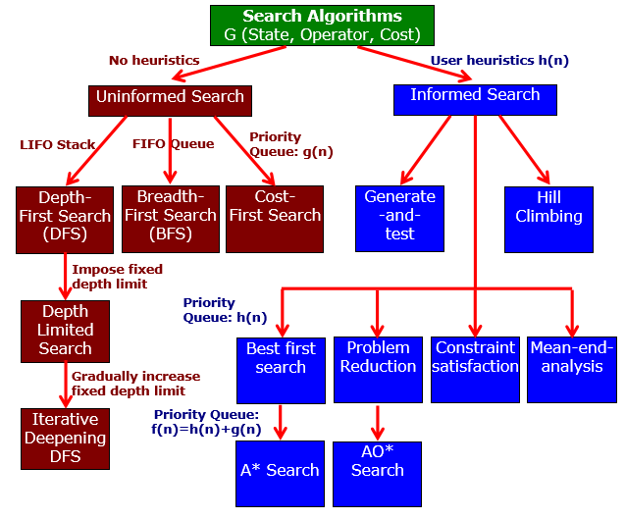
Searching Algorithms

Slide 21
Searching
Examine different possible sequences of actions & states, and come up with specific sequence of operators/actions that will take you from the initial state to the goal state
  Given a state space with initial state and goal state, find optimal sequence of actions leading through a sequence of states to the final goal state
Searching in State Space
  Choose min-cost/max-profit node/state in the state space,
  Test the state to know whether we reached to the goal state or not,
  If not, expand the node further to identify its successor.

Slide 22
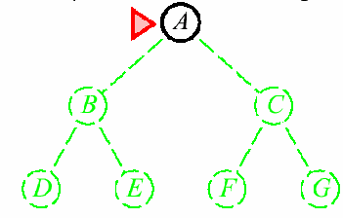
Search Tree
  A search tree is a representation
    in which nodes denote paths and branches connect paths.
    The node with no parent is the root node.
    The nodes with no children are called leaf nodes.
Two functions needed for conducting search
  Generator (or successors) function: Given a state and action, produces its successor states (in a state space)
  Tester (or IsGoal) function: Tells whether given state S is a goal state
  IsGoal(S) → True/False
  IsGoal and Successors functions depend on problem domain.

Slide 23
Search algorithm
Input: a given problem (Initial State + Goal state + transit states and operators)
Output: returns optimal sequence of actions to reach the goal.
Algorithm Evaluation:
  Completeness: will the search always find a solution if a solution exists ?
  Optimality: will the search always find the least cost solution? (when actions have costs)
  Time complexity: how long does it take to find a solution ?
  Space complexity: what is the maximum space used by the algorithm ?
Fast programs can be written But they use up too much memory
Memory efficient programs can be written But they are slow

Slide 24
Search strategy
Uninformed (blind) search
  They do not need domain knowledge that guide them to the right direction towards the goal
  Have no information about the number of steps or the path cost from the current state to the goal
  It is important for problems for which there is no additional information to consider
  They work fine with small number of possible states

Slide 25
Cont.
Informed (heuristic) search
  Have problem-specific knowledge (knowledge that is true from experience)
  Have knowledge about how far are the various state from the goal
  Can find solutions more efficiently than uninformed search

Slide 26
Cont.
Uninformed search
  Breadth first
  Depth first
  Uniform cost, …
  Depth limited search
  Iterative deepening
  etc.
Informed search
  Greedy search
  A*-search
  Iterative improvement,
  Constraint satisfaction
  etc.

Slide 27
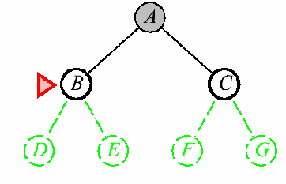
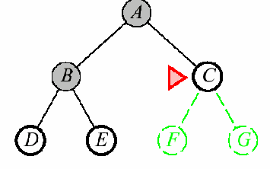
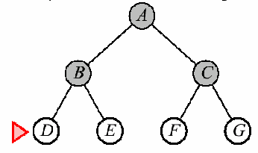
Uninformed search-Breadth first search
Expand all nodes on a given level of the search tree before moving to the next level
Implementation: use FIFO queue data structure to store the list:
  New successors at the end of queue
  Pop nodes from the front of the queue
Properties:
  Takes space: keeps every node in memory
  Optimal and complete: guarantees to find solution

Slide 28
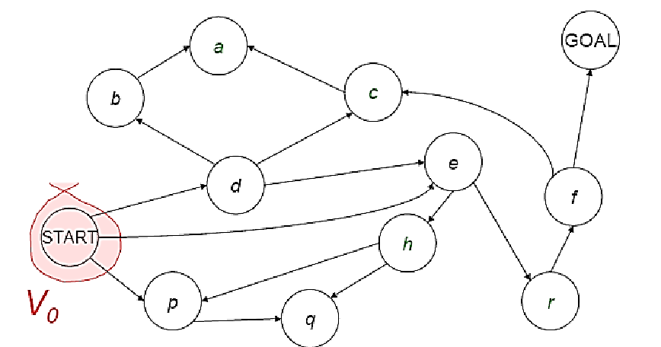
Example
Visiting a vertex – Going to a particular vertex
Exploration of Vertex - Visiting all adjacent vertexes

Slide 29
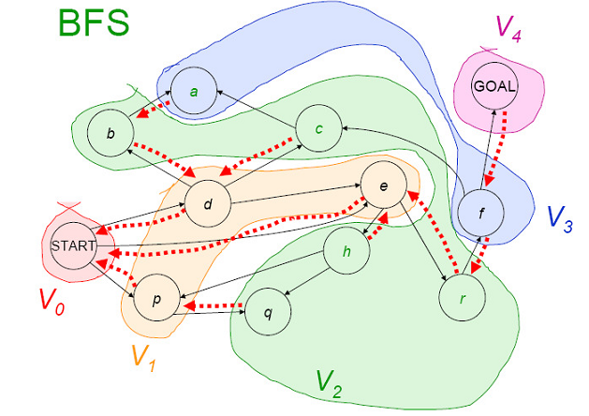
Cont.
Solution is:
Start => e => r => f => Goal

Slide 30
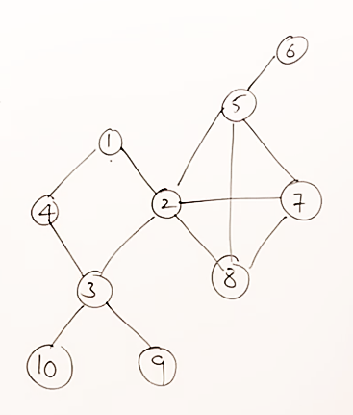
Exercise
1 is the starting point and 6 is the goal
Identify the possible path to reach the goal using BFS

Slide 31
Cont.
If branching factor (average number of child nodes for a given node) = b and depth = d, then number of nodes at level d =b^{d}
The total no of nodes created in worst case is b + b² + b³ + …… + b^{d}
Disadvantage: Since each level of nodes is saved for creating next one, it consumes a lot of memory space

Slide 32
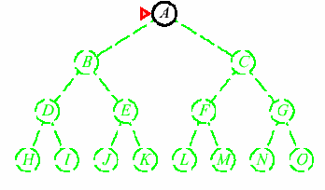
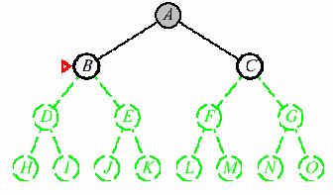
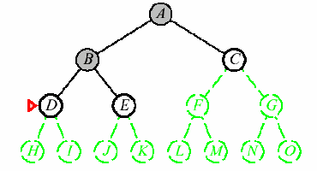
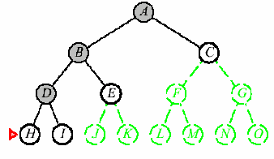
Uninformed search-Depth-first search
Expand one of the node at the deepest level of the tree.
  Only when the search hits a non-goal dead end does the search go back and expand nodes at shallower levels
Implementation: treat the list as LIFO Stack
  New successors at the top of stack
  Pop nodes from the top of the stack
Properties
  Incomplete and not optimal: fails in infinite-depth spaces, spaces with loops.
  Takes less space (Linear): Only needs to remember up to the depth expanded

Slide 33
Example
Solution is:
Start => e => r => f => Goal

Slide 34
Exercise
1 is the starting point and 6 is the goal
Identify the possible path to reach the goal using DFS

Slide 35
Cont.
Disadvantage: This algorithm may not terminate and go on infinitely on one path
  The solution to this is to choose a cut-off depth

Slide 36
Uniformed Searching strategy
BFS | DFS
BFS Stands for “Breadth First Search”. | DFS stands for “Depth First Search”.
BFS starts traversal from the root node and then explore the search in the level by level manner i.e. as close as possible from the root node. | DFS starts the traversal from the root node and explore the search as far as possible from the root node i.e. depth wise.
Breadth First Search can be done with the help of queue i.e. FIFO implementation. | Depth First Search can be done with the help of Stack i.e. LIFO implementations.
This algorithm works in single stage. The visited vertices are removed from the queue and then displayed at once. | This algorithm works in two stages – in the first stage the visited vertices are pushed onto the stack and later on when there is no vertex further to visit those are popped-off.
BFS is slower than DFS. | DFS is more faster than BFS.
BFS requires more memory compare to DFS. | DFS require less memory compare to BFS.
Applications of BFS > To find Shortest path > Single Source & All pairs shortest paths > In Spanning tree > In Connectivity | Applications of DFS > Useful in Cycle detection > In Connectivity testing > Finding a path between V and W in the graph. > useful in finding spanning trees & forest.
BFS is useful in finding shortest path.BFS can be used to find the shortest distance between some starting node and the remaining nodes of the graph. | DFS in not so useful in finding shortest path. It is used to perform a traversal of a general graph and the idea of DFS is to make a path as long as possible, and then go back (backtrack) to add branches also as long as possible.

Slide 37
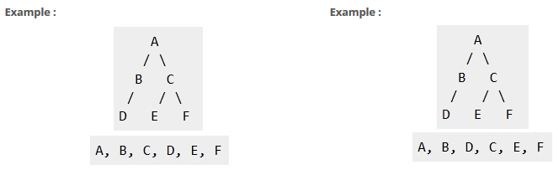
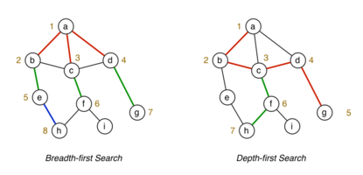
Difference between BFS and DFS | BFS vs. DFS

Slide 38
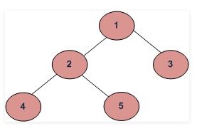
BFS vs DFS for Binary Tree
What are BFS and DFS for Binary Tree?
A Tree is typically traversed in two ways:
Breadth First Traversal (Or Level Order Traversal)
Depth First Traversal
  In order Traversal (Left-Root-Right)
  Preorder Traversal (Root-Left-Right)
  Post order Traversal (Left-Right-Root)
BFS and DFSs of above Tree
Breadth First Traversal : 1 2 3 4 5
Depth First Traversals:
In order Traversal : 4 2 5 1 3
Preorder Traversal : 1 2 4 5 3
Post order Traversal : 4 5 2 3 1

Slide 39
Discussion Point
Compare breadth-first and depth-first search.
  When would breadth-first be preferable?
  When would depth-first be preferable?
Breadth-First:
  When completeness is important.
  When optimal solutions are important.
Depth-First:
  When solutions are dense and low-cost is important, especially space costs.

Slide 40
Assignment - 1
Read and discuss each of the following searching algorithms using an example clearly.
  Uniform-Cost Search
  Iterative Deepening Search (IDS)
  Bidirectional Search
  Depth limited search

Slide 41
Informed search
In uninformed search, we don’t try to evaluate which of the nodes on the frontier/limit are most promising.
Search efficiency would improve greatly if there is a way to order the choices so that the most promising are explored first.
  This requires domain knowledge of the problem (i.e. heuristic) to undertake focused search.

Slide 42
Cont.
A Heuristic is an operationally-effective piece of information on how to direct search in a problem space.
Heuristics are only approximately correct. Their purpose is to minimize search on average.
  It is an estimate of how close we are to a goal state
  h(n) = guesses the cost of getting to the goal from node n
There are different ways of guessing this cost in different domains. I.e., heuristics are domain specific.

Slide 43
Cont.
Search algorithms are admissible with respect to a search method if it guarantees finding the optimal solution first, even when its value is only an estimate.
  The algorithm always terminates in an optimal path from the initial state to goal node if one exists.

Slide 44
Informed search- Best-first search
It is a generic name to the class of informed methods
The two best first approaches to find the shortest path:
  Greedy Search
  A*Search
When expanding a node n in the search tree, greedy search uses the estimated cost to get from the current state to the goal state, define as h(n).
And A*Search uses h(n) and the sum of the cost to reach that node from the start state, define as g(n).

Slide 45
Cont.
For each node in the search tree, an evaluation function f(n) can be defined as the sum of these functions.
f(n) = g(n) + h(n)
The heuristic value of
node n
The estimated cost of
achieving the goal
(from node n to the goal)
The actual cost of
node n
(from the root to n)

Slide 46
Informed search- Greedy best-first search
Is a best first search that uses a heuristic function h(n) alone to guide the search
  Selects node to expand that is closest to a goal node (hence it’s greedy)
  The algorithm doesn’t take minimum path costs from initial to current nodes into account
  Always expand node with lowest h-value.
Implementation:
  expand 1st the node closest to the goal state, i.e. with evaluation function f(n) = h(n)
  h(n) = 0 if node n is the goal state
  Otherwise if h(n) ≥ 0; continue with an estimated cost of the cheapest path from node n to a goal state

Slide 47
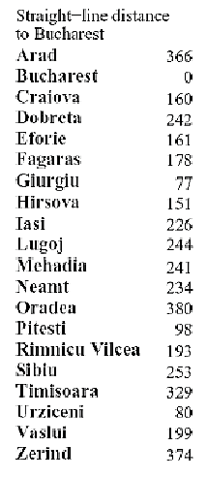
Cont.
E.g.
h(n)

Slide 48
Cont.
Solution
  We use h(n) to rank the nodes on the frontier.

Slide 49
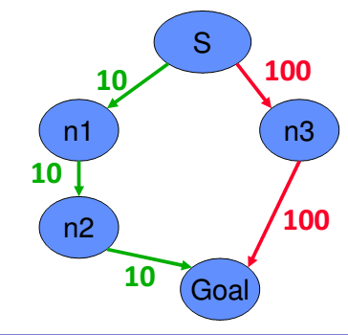
Cont.
However, this method ignores the cost of getting to n, so it can be lead astray exploring nodes that cost a lot to get to but seem to be close to the goal:
E.g. 1
h(n1) = 70
h(n3) = 50
Solution
S => n3 => Goal
Not optimal

Slide 50
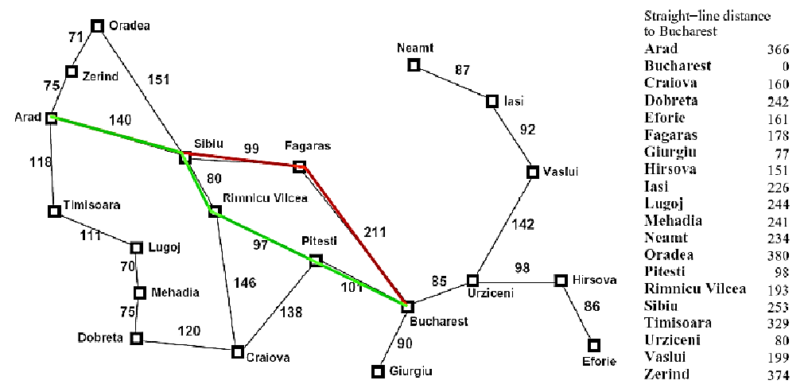
Cont.
E.g. 2
Not optimal

Slide 51
Cont.
Properties
  Incomplete and Not optimal
    May not reach goal state because it may start down an infinite path and never return to try other possibilities
  Exponential time complexity and memory requirement
    It retains all the nodes in memory
    With good heuristic function (that estimate cost nearer to actual cost) the space and time complexity can be reduced substantially
The problem with greedy search is that it didn’t take costs so far into account.
  We need a search algorithm (like A* search) that takes into consideration this cost so that it avoids expanding paths that are already expensive

Slide 52
Informed search- A*-search Algorithm
It considers both estimated cost of getting from n to the goal node h(n), and cost of getting from initial node to node n, g(n)
Apply three functions over every nodes
  g(n): Cost of path found so far from initial state to n
  h(n): Estimated cost of shortest path from n to z
    E.g. in Route finding h(n) is straight line distance
  f(n): Estimated total cost of shortest path from a to z via n
  Evaluation function f(n) = h(n) + g(n)
Implementation: Expand the node for which the evaluation function f(n) is lowest
  Rank nodes by f(n) that goes from the start node to goal node via given node

Slide 53
Cont.
h(n)

Slide 54
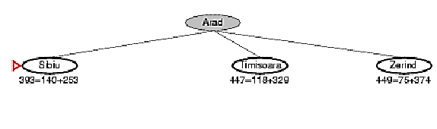
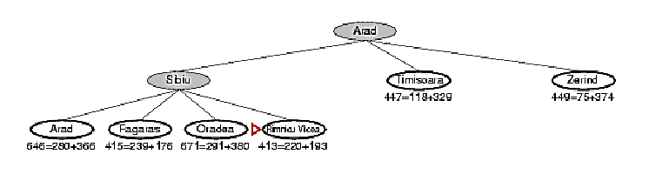
Cont.
Solution

Slide 55
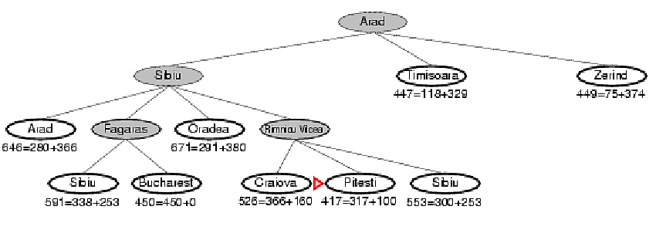
Cont.

Slide 56
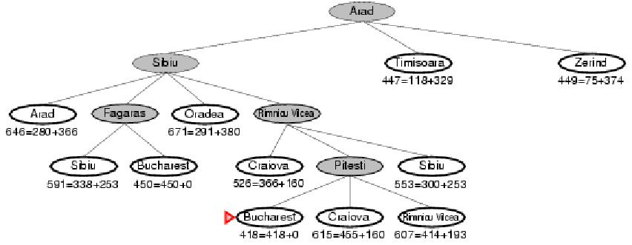
Cont.
  h(n) = 0 it is the goal state

Slide 57
Cont.

Slide 58
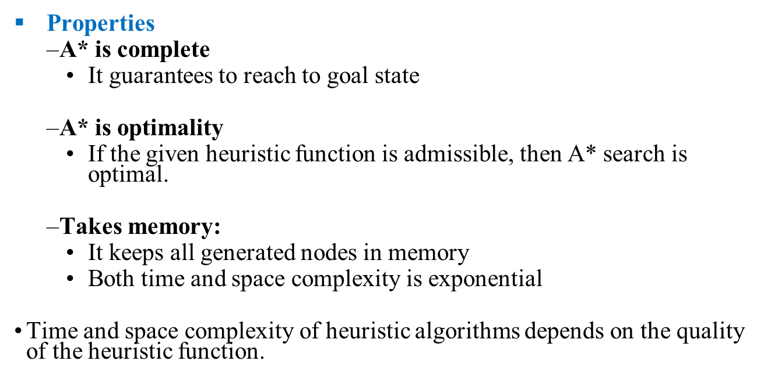
Cont.

Slide 59
Assignment - 2
Read and discuss each of the following searching algorithms using an example clearly.
  AO* search
  Iterative improvement,
  Constraint satisfaction
  Problem reduction
  Hill climbing
  Generate and test

Slide 60
Group Assignment (Due: 30 days)
Consider one of the following problem:
  Missionary-and-cannibal problem
  Towers of Hanoi
  Tic-Tac-Toe
  Travelling salesperson problem
  8-queens problem
  5 sticks
  Water Jug Problem(3:4; 4:5)
  8-puzzle problem
  Monkey and Bananas problem
  Crypt arithmetic
Identify the set of states and operators; based on which construct the state space of the problem
write goal test function
Determine path cost
Implement the solution

